Slide 1
Disaster Tweets Classification Using pySpark
CS777 Term project
Maryam Asghari

Slide 2
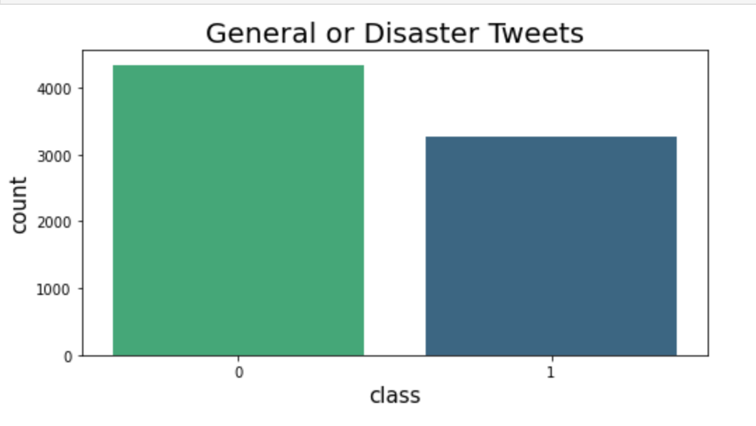
Dataset

Slide 3
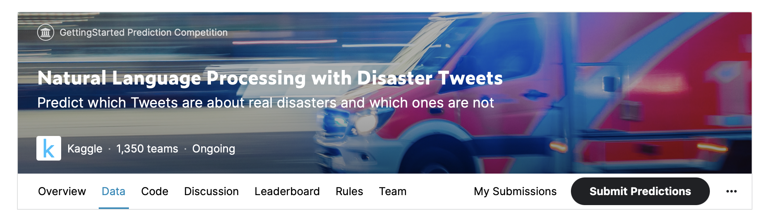
Dataset
Columns
id - a unique identifier for each tweet
text - the text of the tweet
location - the location the tweet was sent from (may be blank)
keyword - a particular keyword from the tweet (may be blank)
target - in train.csv only, this denotes whether a tweet is about a real disaster (1) or not (0)
Source : https://www.kaggle.com/c/nlp-getting-started/data

Slide 4
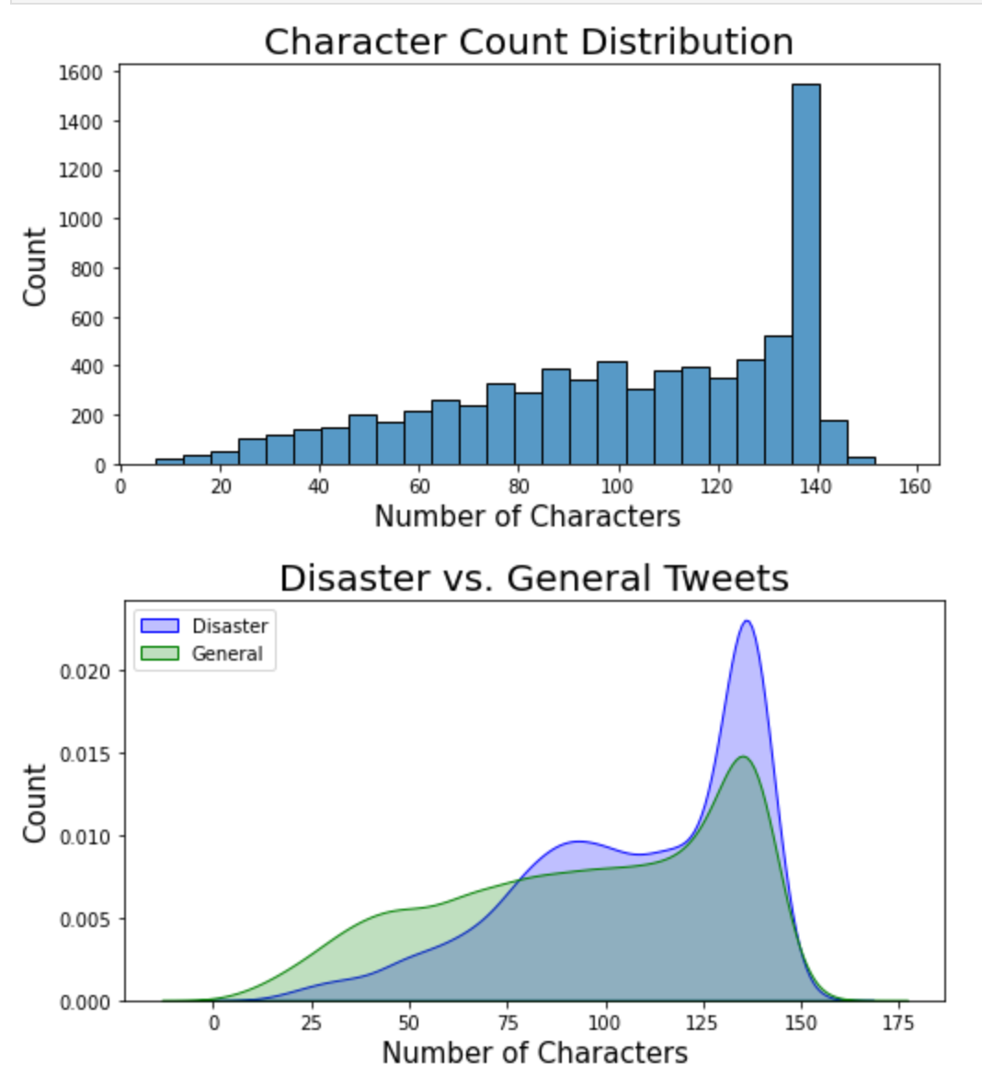
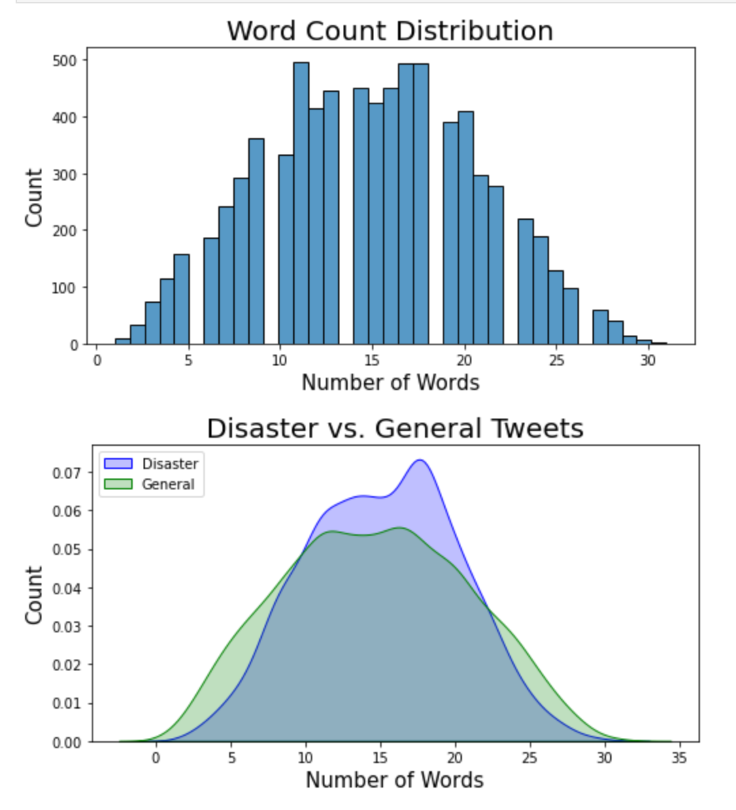
Character and Words

Slide 5
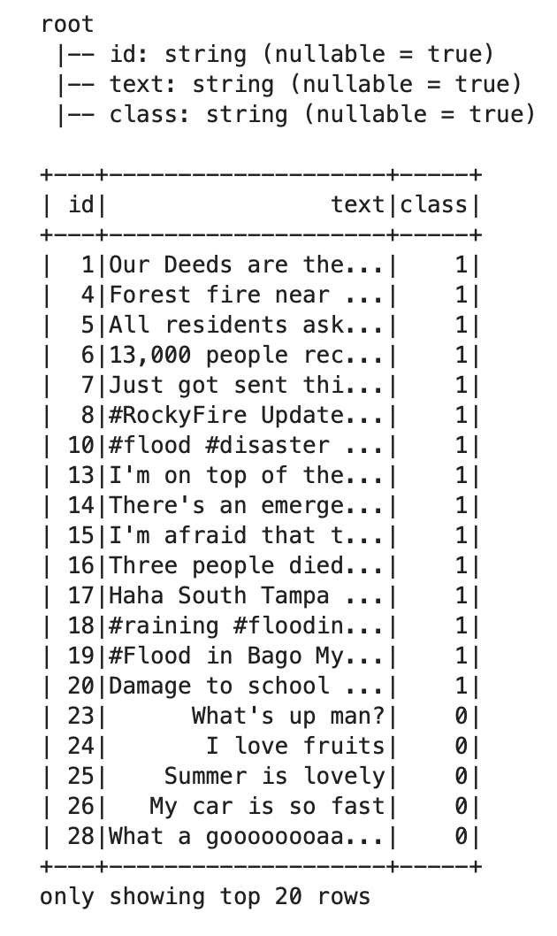
Preprocessing

Slide 6
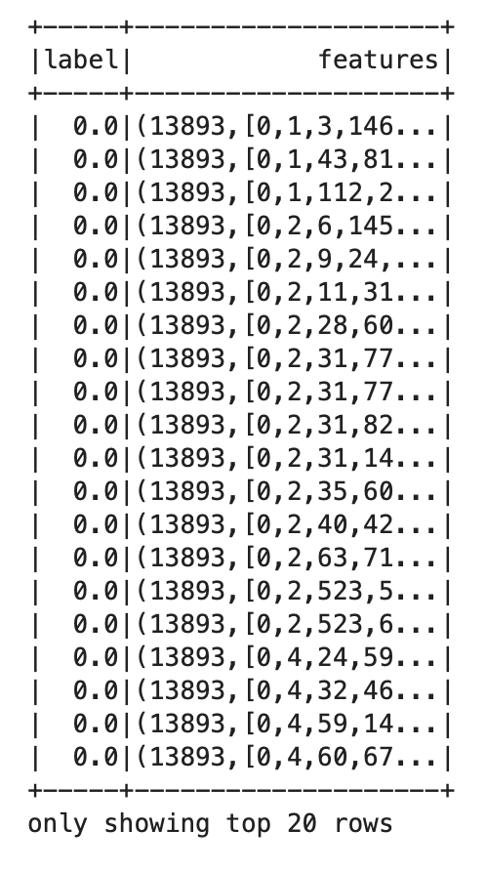
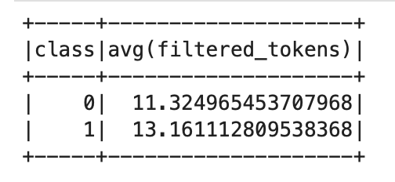
Using UDF and Libraries
Lower case
Remove websites and mentions
Remove all non letter characters
Remove Stop words
Tokenize
Tf_idf
Vector of features
Split to train and test set
Average word count in each group

Slide 7
Classification Using ml libraries
Naïve Bayes
Logistic Regression
SVM
Decision Tree
Random Forest
GBT - Gradient Boosted Tree

Slide 8
Using Pyspark Libraries for Classification
Classifier | Lib | DS | Accuracy | F1 | Train T | Test T
Logistic Regression | Ml | dataframe | %79.16 | %78.2 | 6.698 | 0.0311
SVM | Ml | dataframe | %78.02 | %77.60 | 44.4904 | 0.0226
Naïve Bayes | Ml | dataframe | %78.41 | %78.4 | 4.5829 | 0.0354
Decision Tree | Ml | dataframe | %60.62 | %49.9 | 12.4768 | 0.0373
Random Forest | Ml | dataframe | %62.09 | %52.30 | 5.03 | 0.037
GBT | Ml | dataframe | %73.45 | %71.5 | 39.57 | 0.0539

Slide 9
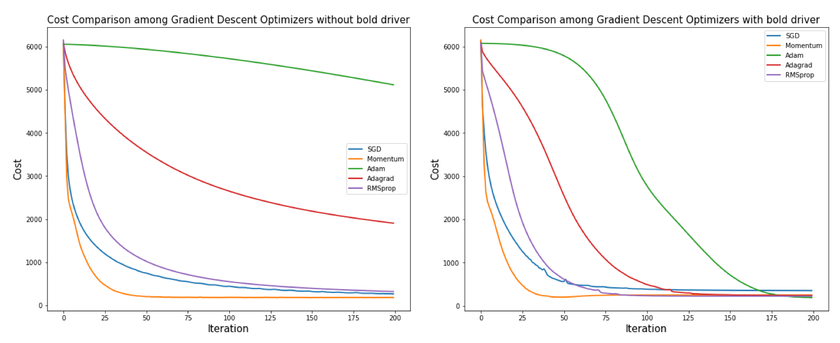

Slide 10
Different regularization parameter
Reg parameter | Accuracy | F1
0.0001 | %74.56 | %774.53
0.001 | %75.81 | %75.71
0.01 | %77.57 | %77.39
0.1 | %77.82 | %77.47
1 | %78.38 | %77.45
10 | %65.60 | %57.65
Reg parameter | Accuracy | F1
0.0001 | %76.31 | %76.19
0.001 | %76.31 | %76.2
0.01 | %76.25 | %76.14
0.1 | %77.22 | %77.09
1 | %77.73 | %77.51
10 | %60.91 | %48.20
Logistic regression
SVM

Slide 11
Implementations from scratch
Preprocessing
Dictionary of top 10k
Classification

Slide 12
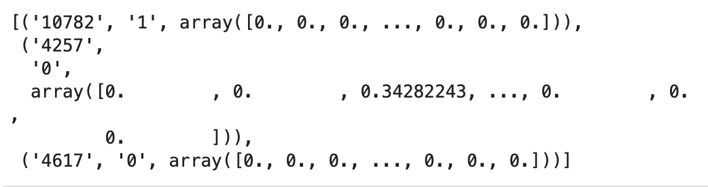
Preprocessing Using NLTK
Lower case
Remove websites and mentions
Remove all non letter characters
Remove Stop words
lemmatize
Tokenize
Tf_idf
Vector of features
Split to train and test set

Slide 13

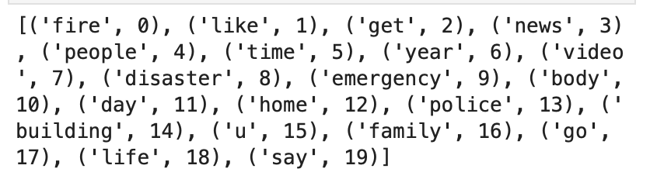
Dictionary of words

Slide 14


Disaster vs. Non-Disaster

Slide 15
RDD Implementations
- Logistic regression with Different Gradient Descent Optimizers
- SVM with Different Gradient Descent Optimizers
- 3 layers Neural Network with SDG and Adam optimizer

Slide 16
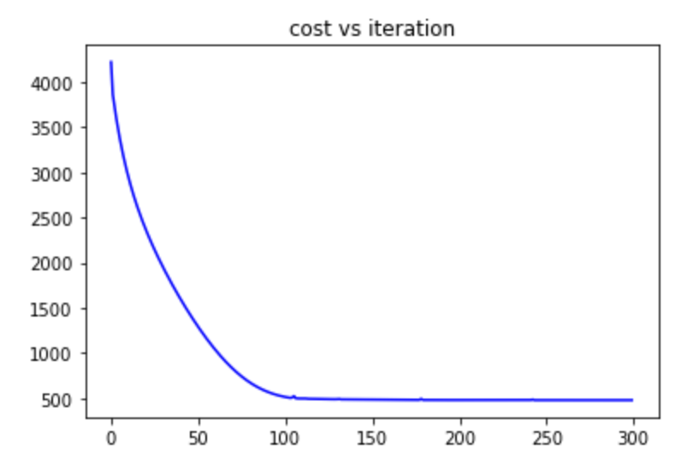
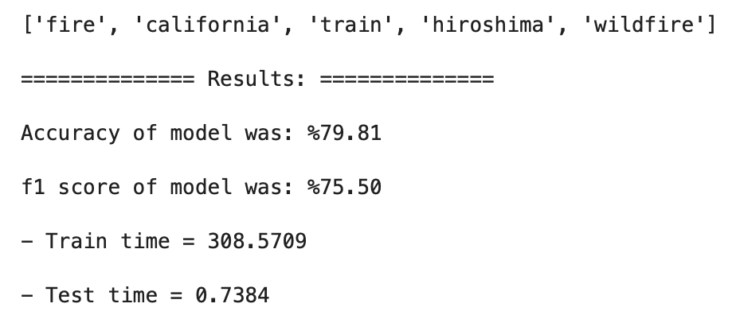
Logistic Regression
The top 5 words with largest coefficients
Dictionary | DS | Accuracy | F1
10K Top All | RDD | %79.81 | %75.50
10K Top Disaster | RDD | %79.25 | %74.86

Slide 17
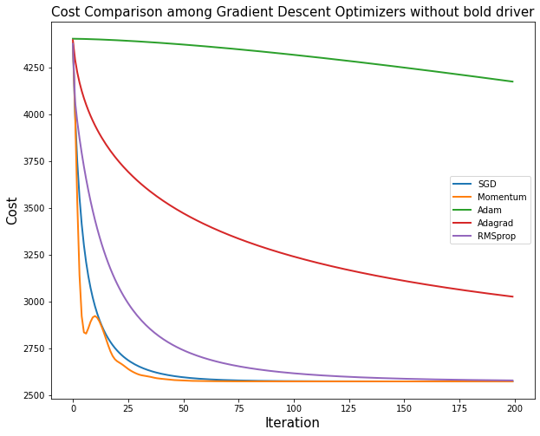
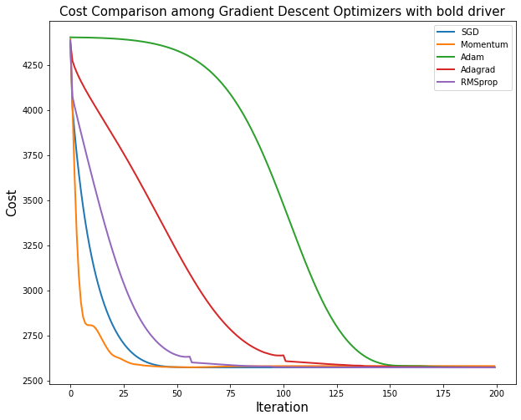
Logistic Regression with different Gradient Descent Optimizers

Slide 18
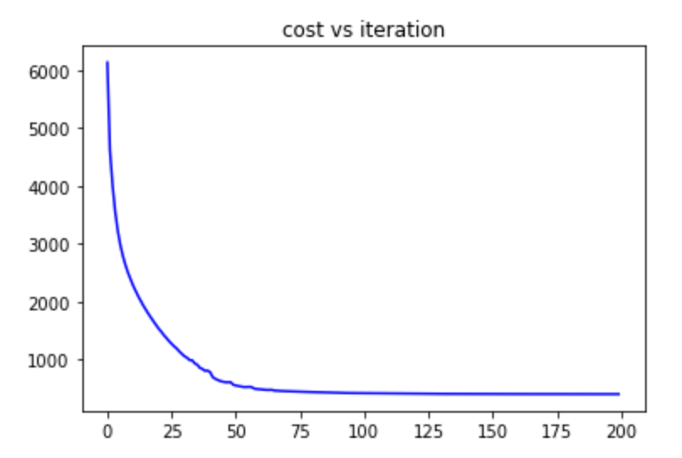
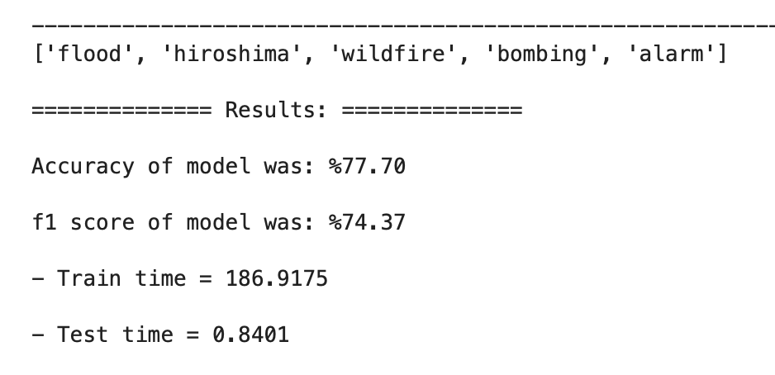
SVM
The top 5 words with largest coefficients

Slide 19
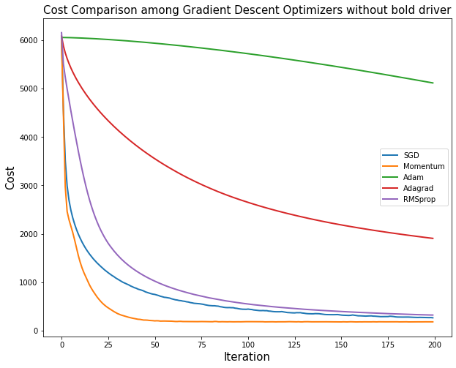
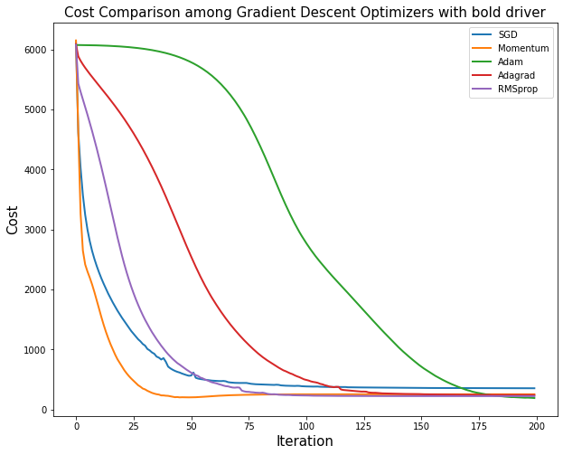
SVM with different Gradient Descent Optimizers

Slide 20
Logistic Regression vs. SVM
Optimizer | Accuracy | F1
SGD | %79.81 | %75.50
Momentum (216 iter) | %80.01 (%80.15) | %75.92 (%76.08)
Nesterov | %79.35 | %76.18
Adam | %79.95 | %75.62
Adagrad | %80.08 | %75.78
RMSprop | %79.88 | %75.56
Optimizer | Accuracy | F1
SGD | %76.31 | %72.92
Momentum | %75.45 | %71.92
Nesterov | %75.31 | %71.72
Adam | %74.12 | %70.27
Adagrad | %73.53 | %69.56
RMSprop | %74.06 | %70.17
Logistic regression , 200 iteration
SVM, 200 iteration

Slide 21
3 layers Neural Network
1000 top words from disaster group
Create the TF-IDF
Layers : [1000 , 128 , 2]
Activation Functions : Leaky ReLU , Sigmoid
SSE cost Function
Optimization :
Stochastic Gradient Descent (SGD)
Adam

Slide 22
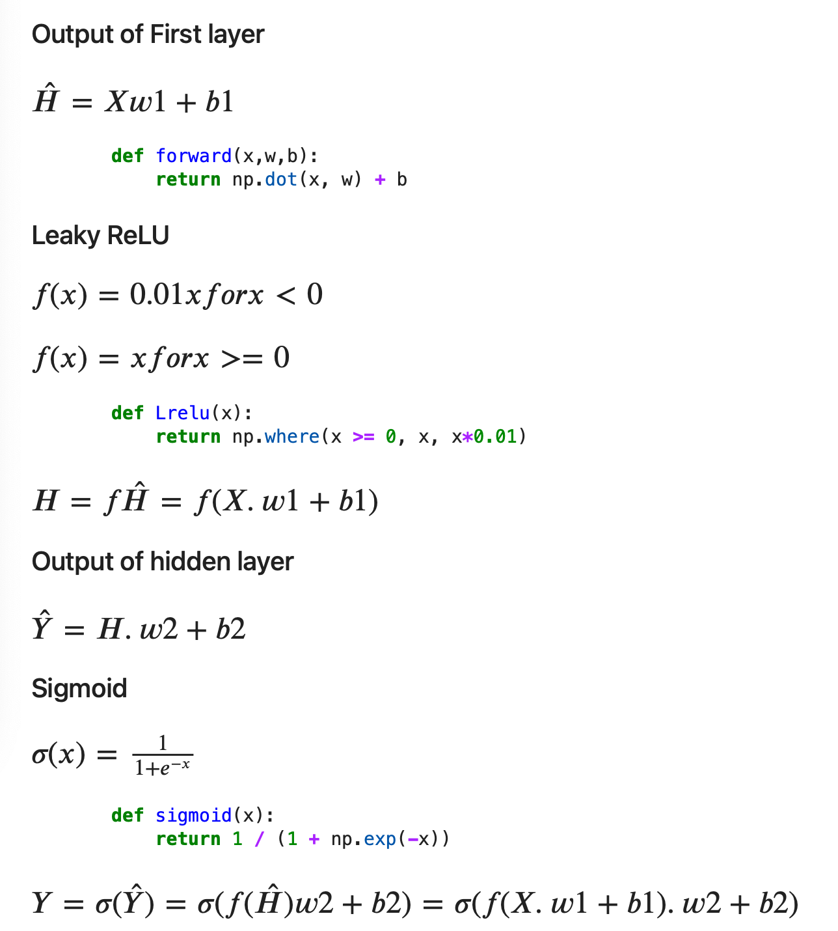
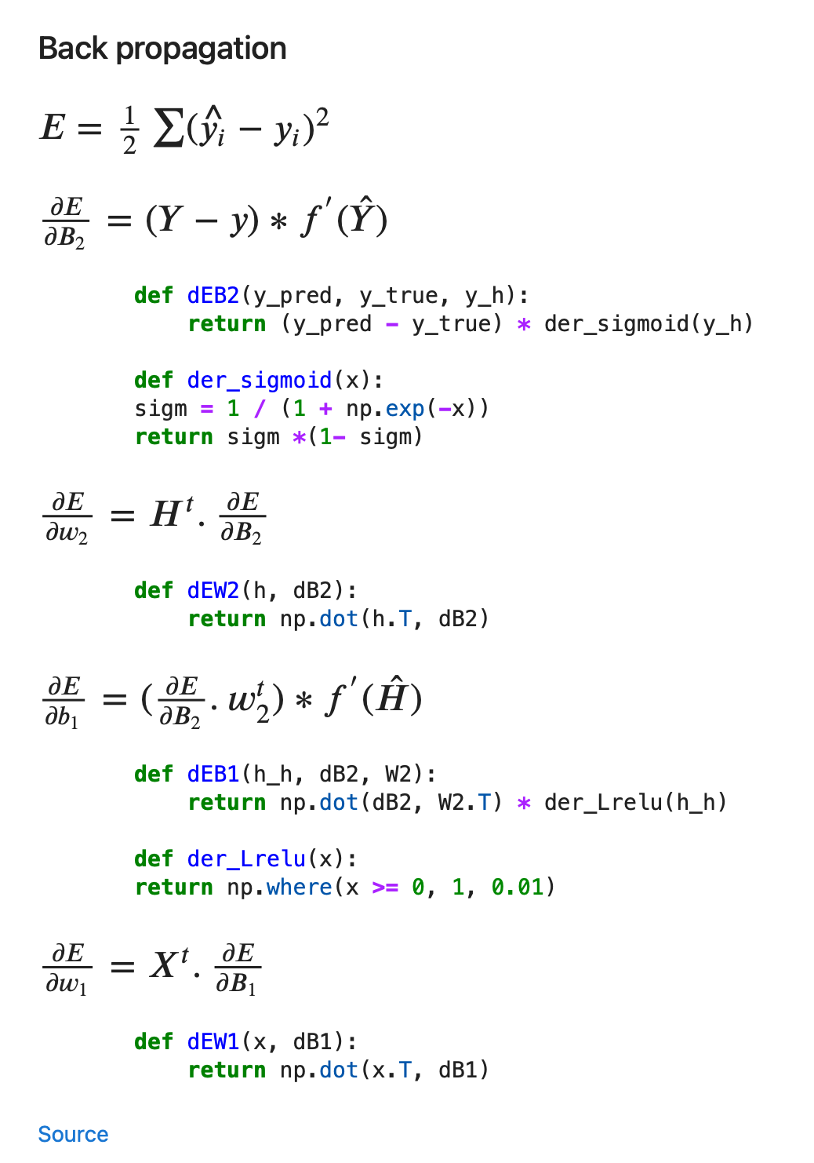
3 layers Neural Network
X
H
Y
.
.
.
.
.
.
.
.
2
128
1000

Slide 23
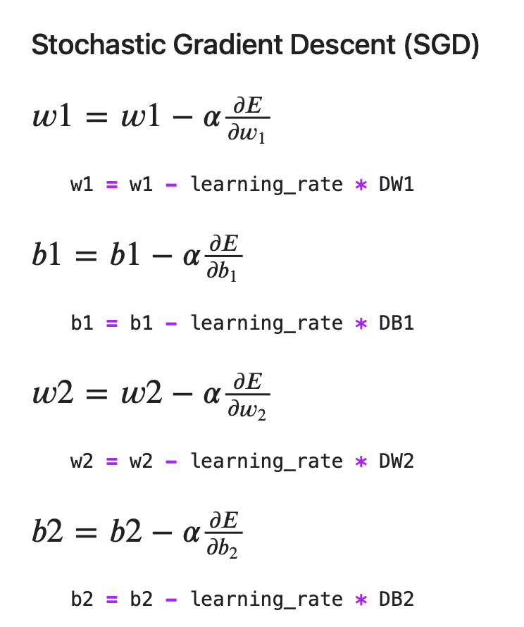
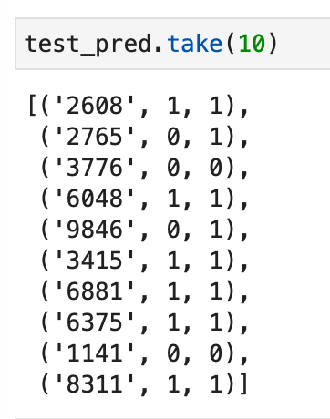
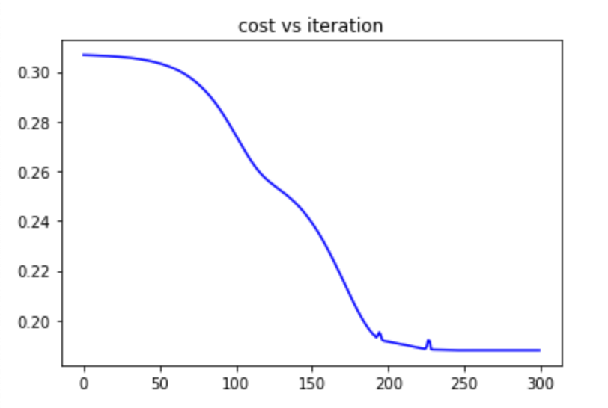
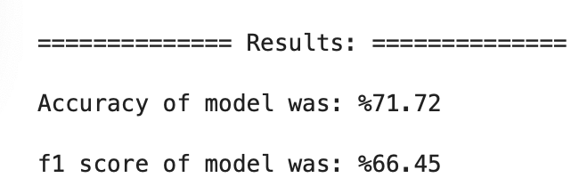
Optimizer SGD

Slide 24
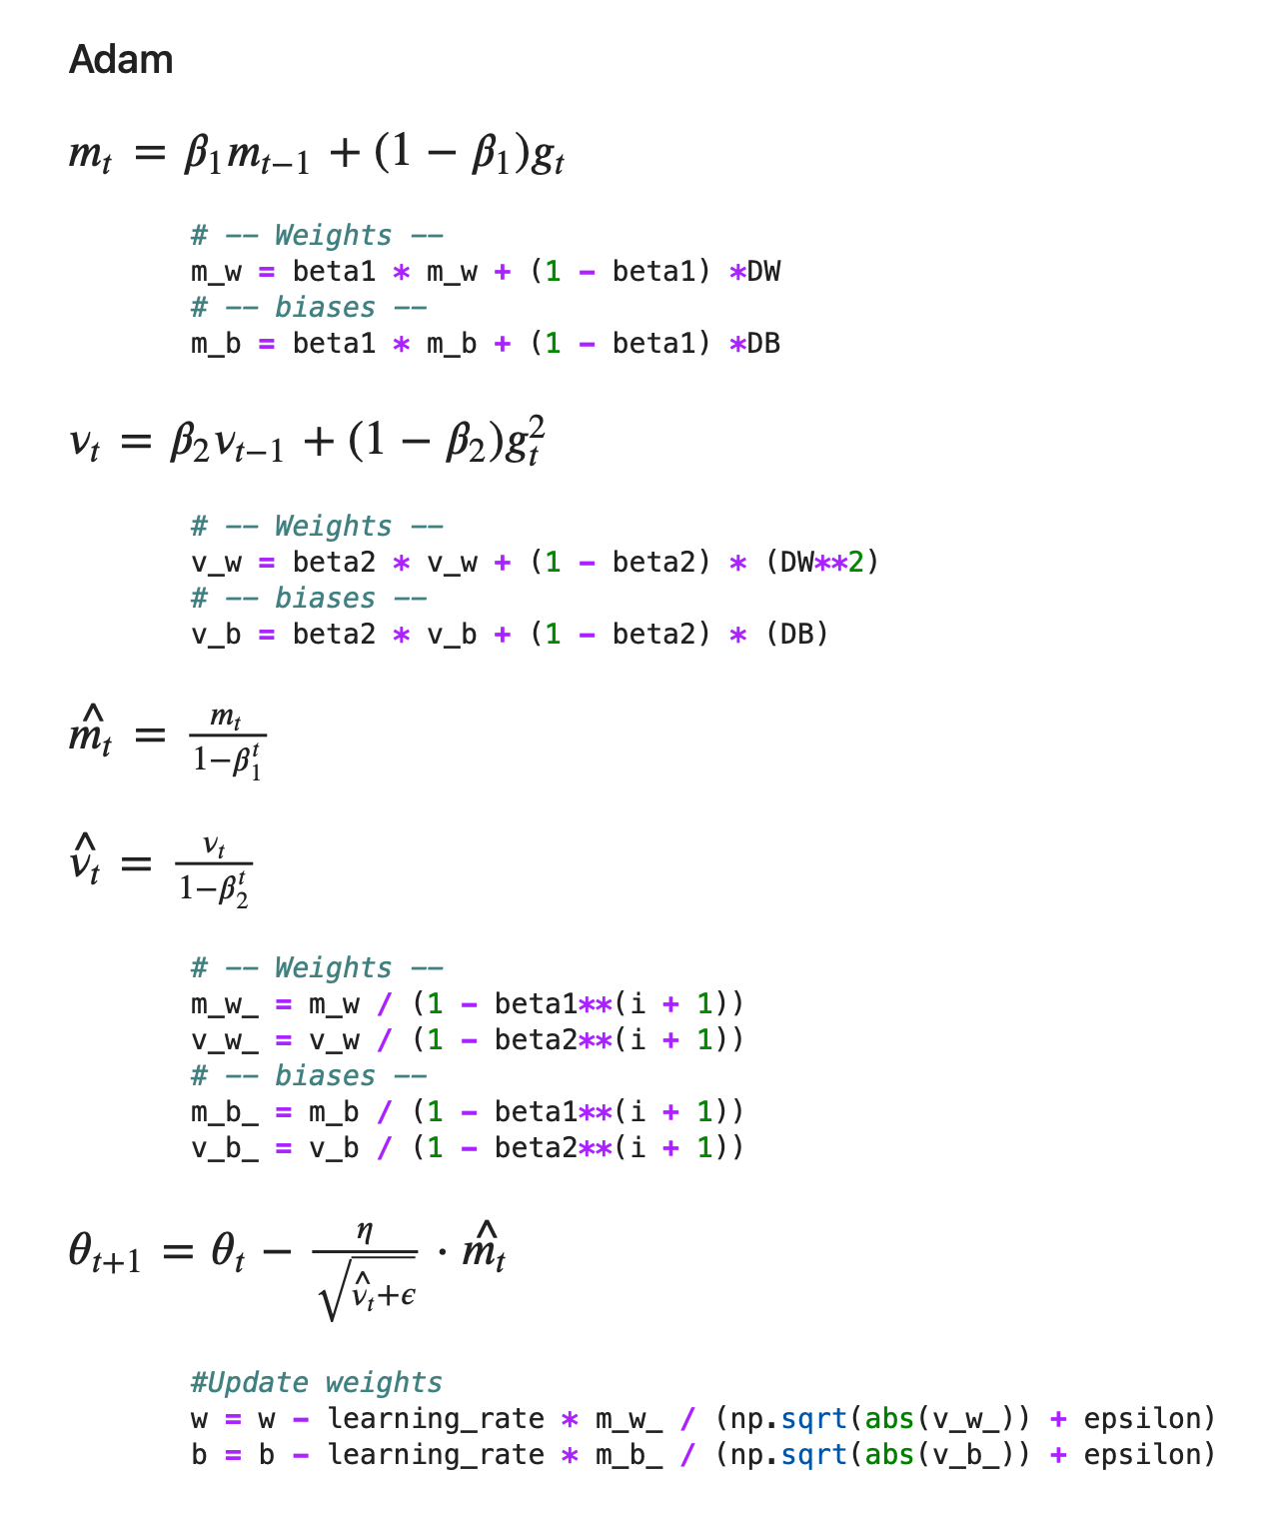
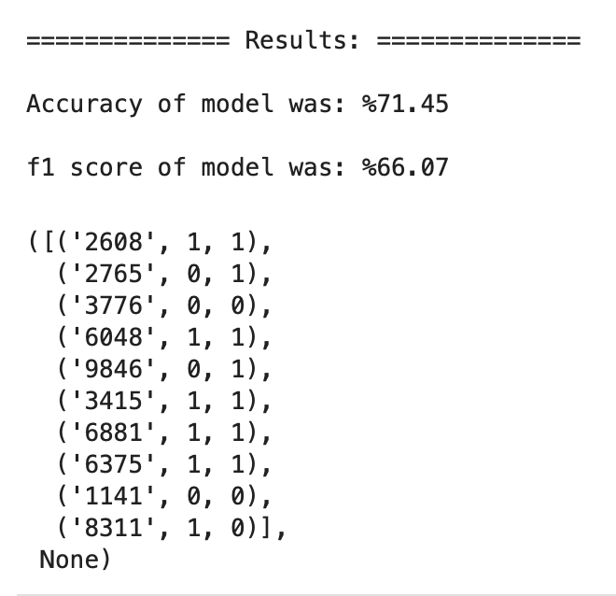
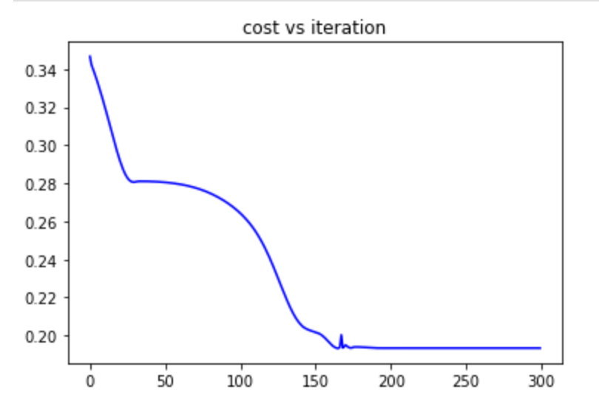
Optimizer Adam

Slide 25
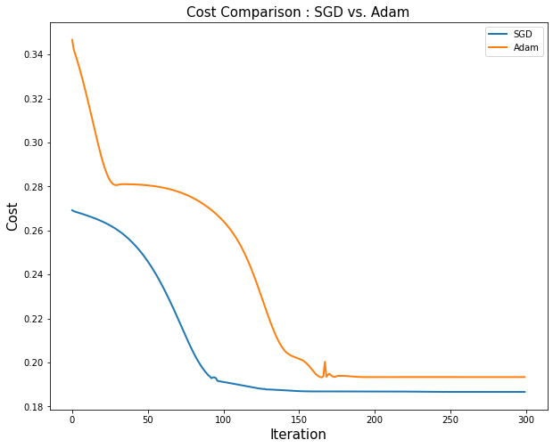
SGD vs. Adam Optimizers

Slide 26
Further study
Improving the Neural network and add more layers
Using tree aggregate instead of RDD
Trying other cost functions
Adding Regulation
Trying other optimization methods
Trying different parameters to improve accuracy

Slide 27
References
https://www.kaggle.com/c/nlp-getting-started
https://spark.apache.org/docs/latest/api/python/index.html
https://github.com/kiat/BigDataAnalytics
https://github.com/kiat/BigDataAnalytics/blob/master/Notebooks/Spark-Example-20-Adam-Sgdm-with-Tree-Aggregate.ipynb
https://medium.com/swlh/mathematics-behind-basic-feed-forward-neural-network-3-layers-python-from-scratch-df88085c8049
https://towardsdatascience.com/pyspark-neural-network-from-scratch-8a19ebad3904
https://himanshuxd.medium.com/activation-functions-sigmoid-relu-leaky-relu-and-softmax-basics-for-neural-networks-and-deep-8d9c70eed91e

Slide 28
Thank you!
Fall 2021

